Slide 1

Neuroscience Data Analysis:
A Beginners Guide

Slide 2
What will you learn in this course
Learn Python Basics
Learn Data Analysis Basics using Pandas, Numpy, SciKit and Matplotlib
Learn about the basics of different data structures in Neuroscience
Learn to load, transform and aggregate Neuroscience data structures

Slide 3

Data Science

Slide 4
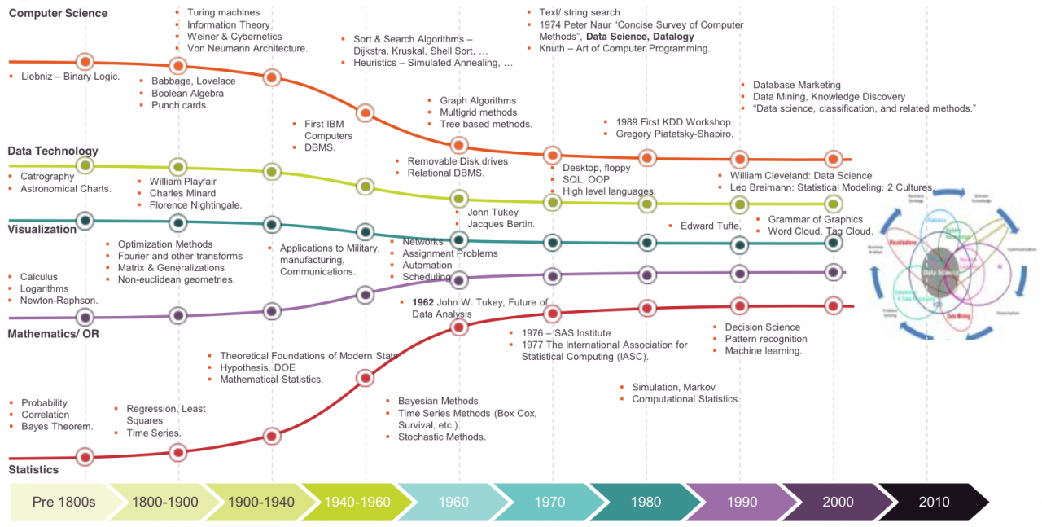
History of Data Science (DS)
http://brighthat.io/a-brief-history-of-data-science/
Notes:
Data Science exist for dozen of years and even centuries
Early on statistcal methods data collectoin and more were evaluated
First neuraal network algorihtm popped out as earyl is in the 40s 50s
Turing was one of the pioneers of machine learning —> developed turing complete machines, what we call now a days computers
Data was always the crucial limiting step
What do you think is the current state of the Art.
Did you ever follow.
What kind of apps you use in your daily live use machine learning, data science and more
Do you maybe also now
What exactly they do?
Is google listening you?
Or is this rather a very good prediction/recommendation system???

Slide 5
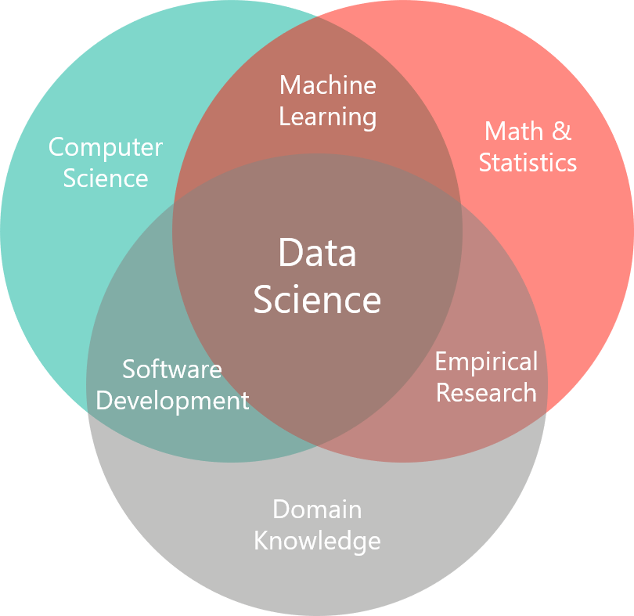
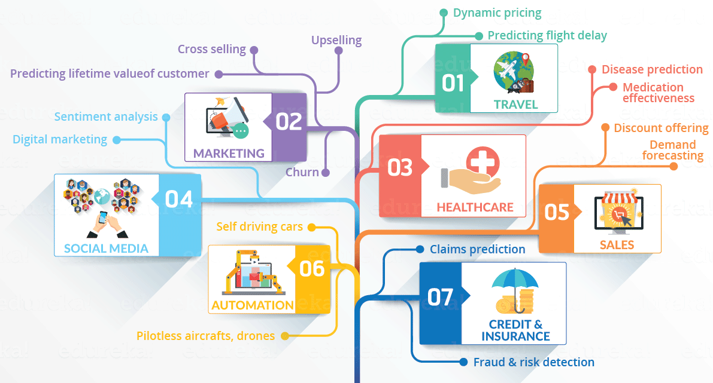
Data Science
https://www.finbridge.de/data-science
https://www.sudeep.co/data-science/2018/02/09/Understanding-the-Data-Science-Lifecycle.html
Notes:
What does data science represents
What are fields data science is heavely used
What are the major bullet points of data science

Slide 6

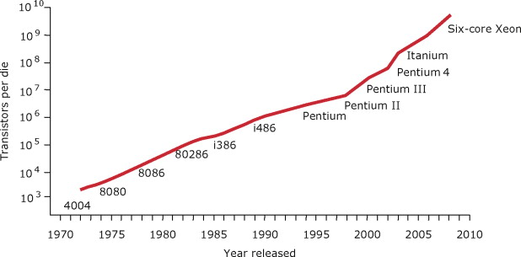
Why did it take so long for DS to kickoff?
https://www.sciencedirect.com/topics/computer-science/processing-power

Slide 7
What kind of data is available
Text/PDF
Tabular
Image
Videos
Webpages

Slide 8

Big Data
Structured Data
Unstructured Data
Volumne
Velocity
Veracity
Validity
Value

Slide 9
Data Analysis Process:
Exploratory Data Analysis -> (80-90% of the Time)
Very important
Bullshit in, bullshit out!
Model Development
The Fun Part!
Model Validation
Model Production
MLops
What is necessary in medical research to deploy a model

Slide 10
Exploratory Data Analysis
Data Exploration
Feature Overview
Feature Distribution
Encoding
Bivariate Analysis
Missing Data and Outlier Detection
Data Cleaning
Feature Engineering
Dimensional Reduction

Slide 11
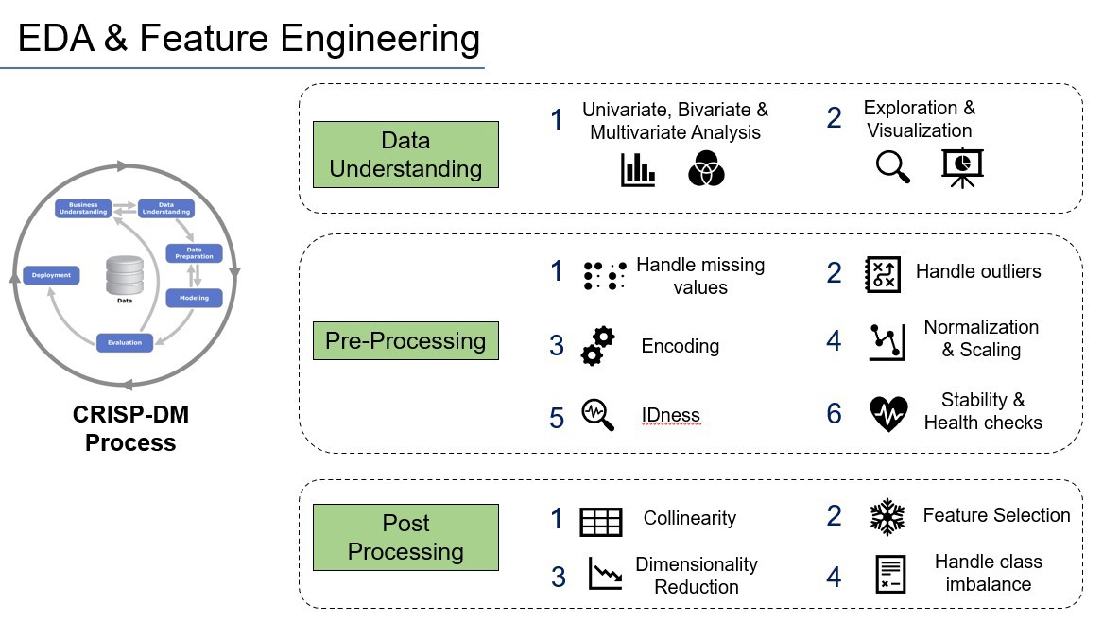
EDA (CRoss Industry Standard Process for Data Mining)
https://medium.com/@mishra.kamal/eda-and-feature-engg-series-handling-missing-values-7b610563ecc

Slide 12




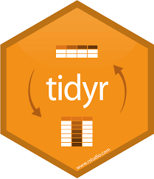

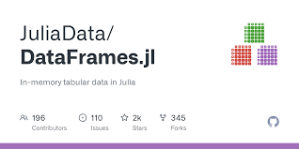

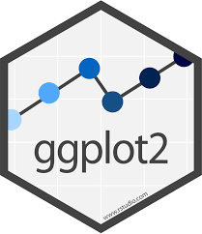
Top Libaries to perform EDA
Notes:
And more

Slide 13

Data Modelling

Slide 14





Most used Packages/Frameworks for Model Training, Prediction and Validation

Slide 15
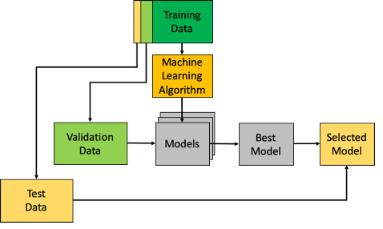
Minimal Data Framework
The Comprehensive Guide to Model Validation Framework (odsc.com)

Slide 16
How to make the data ready for modelling
Dataset
Trainings Dataset
Test
Val
What is the Train set?
What is the Test set?
What is the Validation set?
How can I improve the situation with few data?

Slide 17
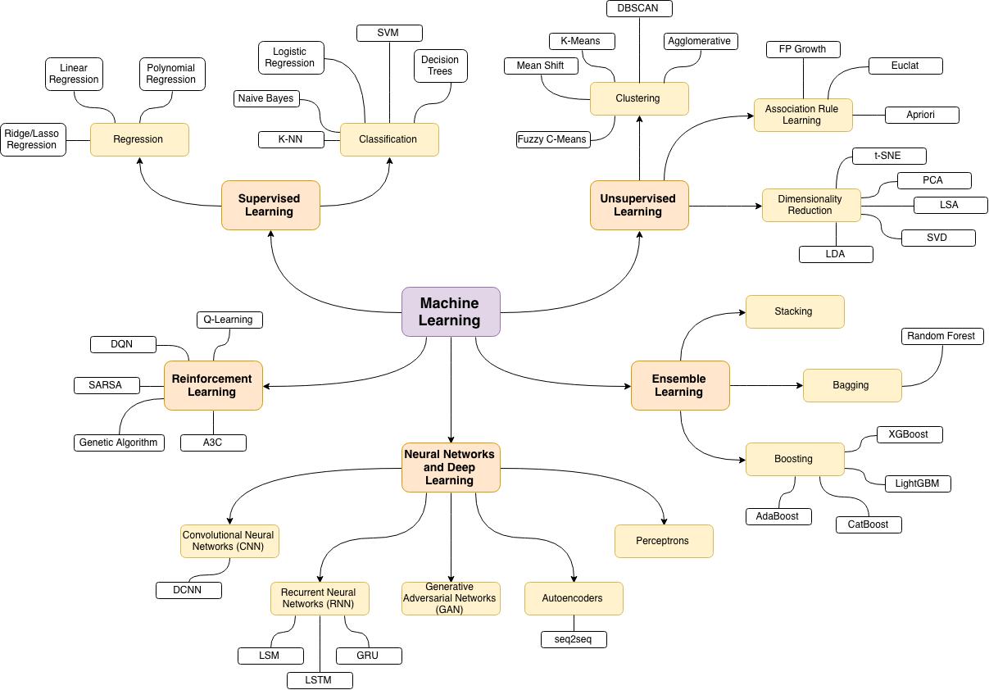
Model Development

Slide 18



Train the Model
Loss Function
Backpropagation
Optimizer
Trainings Data
Labels
Classifier/Regressor/
Neural Networks
Compare Prediction with actual class label

Slide 19
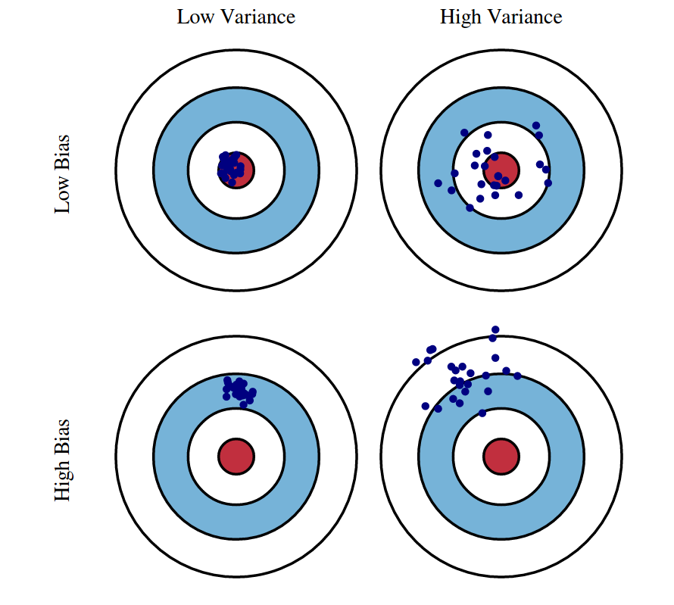
Variance Bias Trade-off
Variance captures how much your model changes if it is trained on a different training set (overfitting/underfitting)
Bias describes a systematic error caused the modelling process itself. We can describe it as the error between an average model and the ground truth of the data
Source: http://scott.fortmann-roe.com/docs/BiasVariance.html

Slide 20
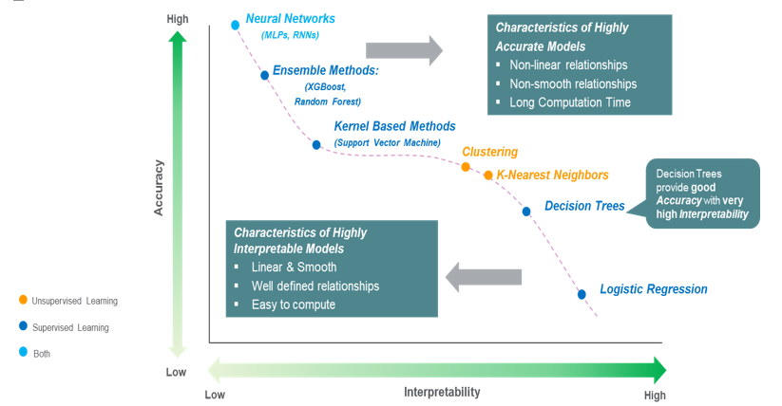
Data Science Model Complexity vs. Intepretability

Slide 21
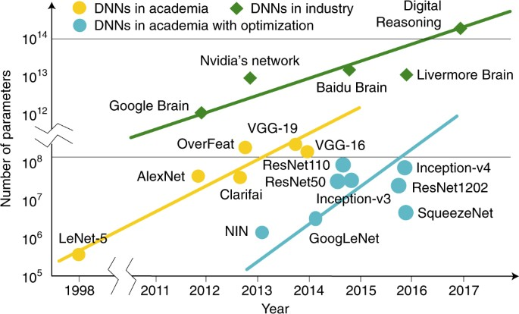
Notes:
End of the short introduction in data modelling

Slide 22

Data Communication

Slide 24





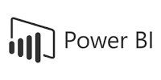
Communication Frameworks for Advanced Data Analytics

Slide 25
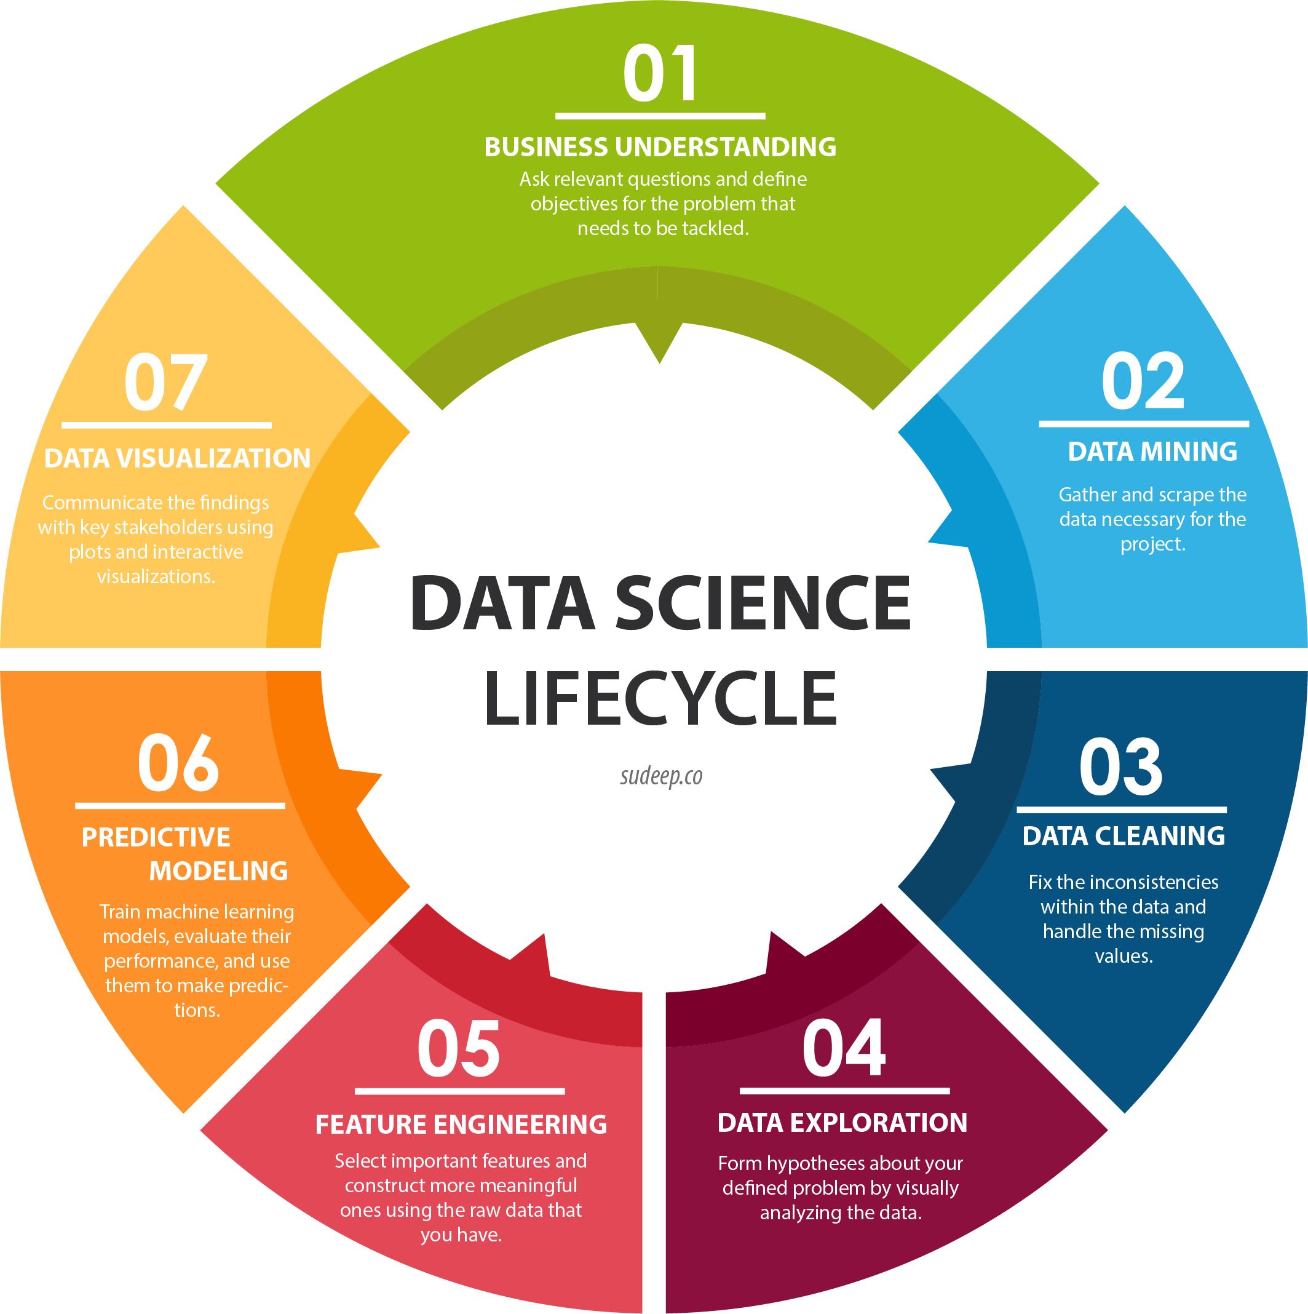

Slide 26
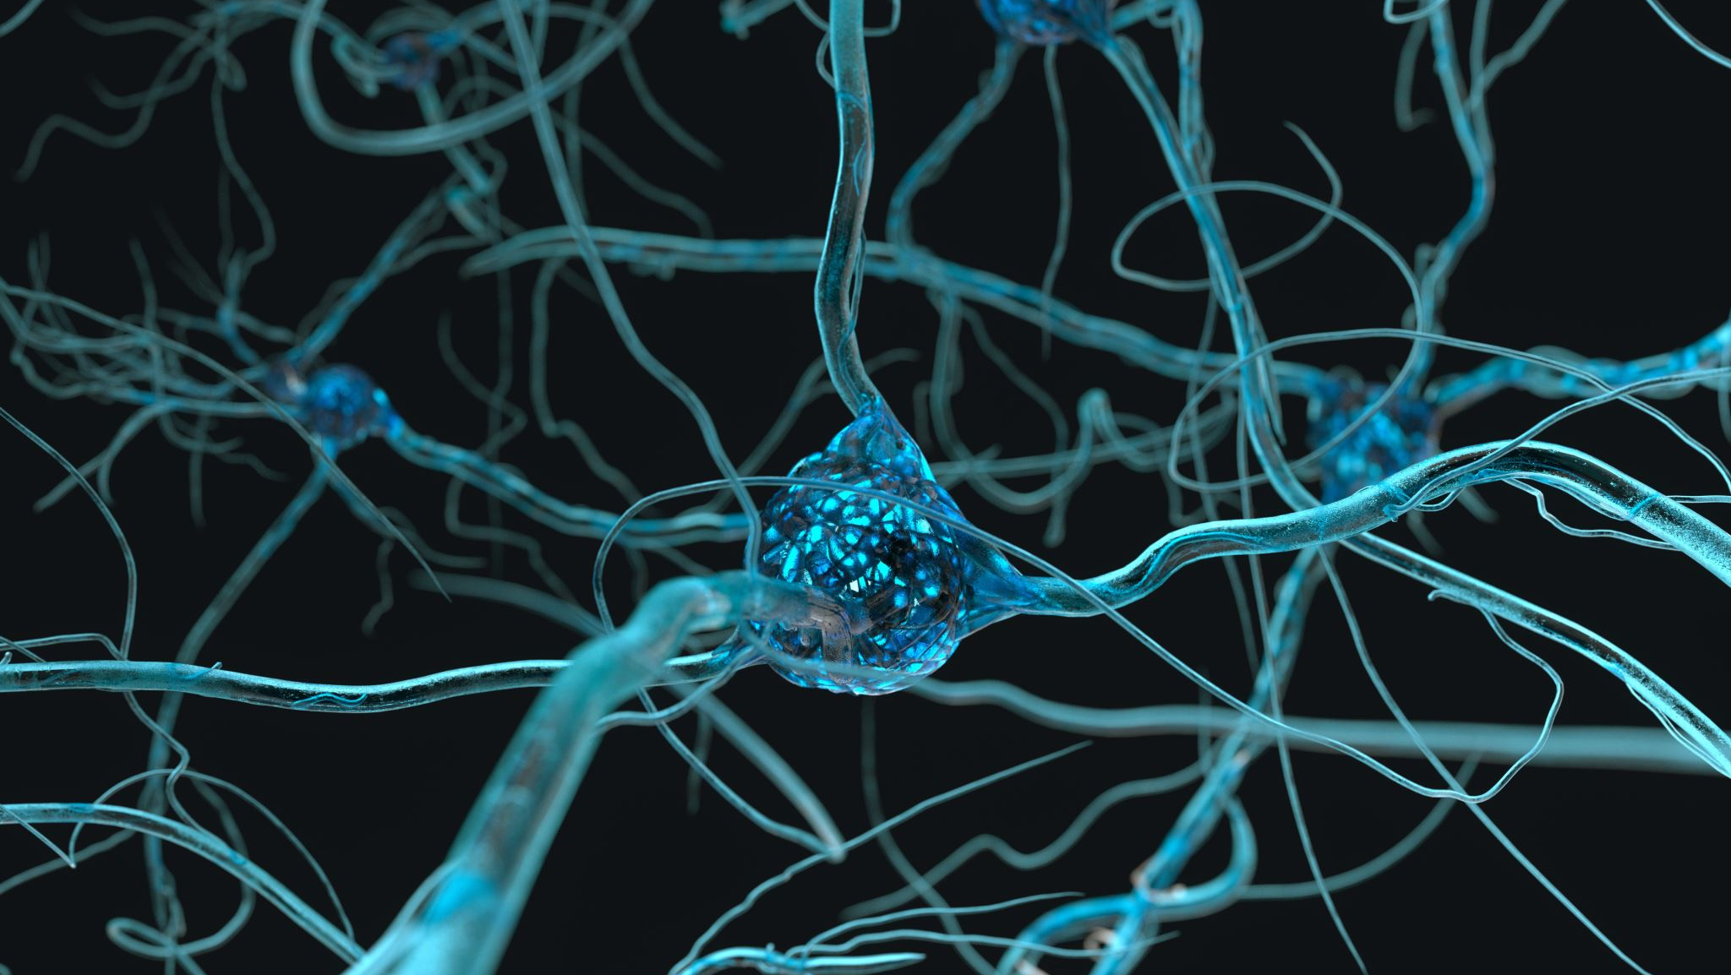
Neuroscience Data

Slide 27
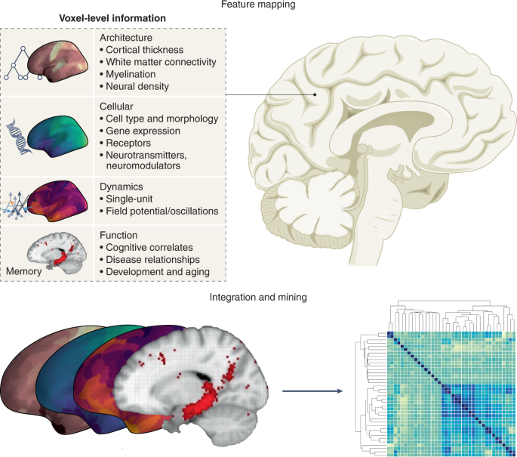
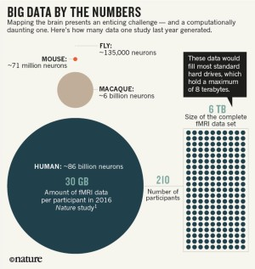
The data science future of neuroscience theory, Nature 2022

Slide 28
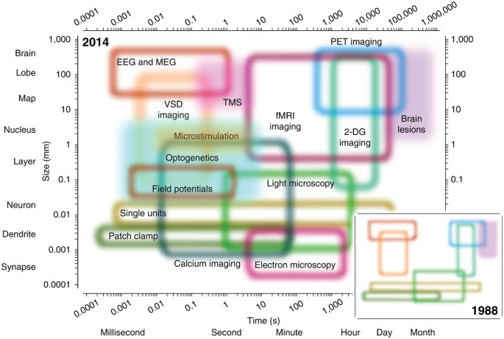
Ref: Putting big data to good use in neuroscience

Slide 29
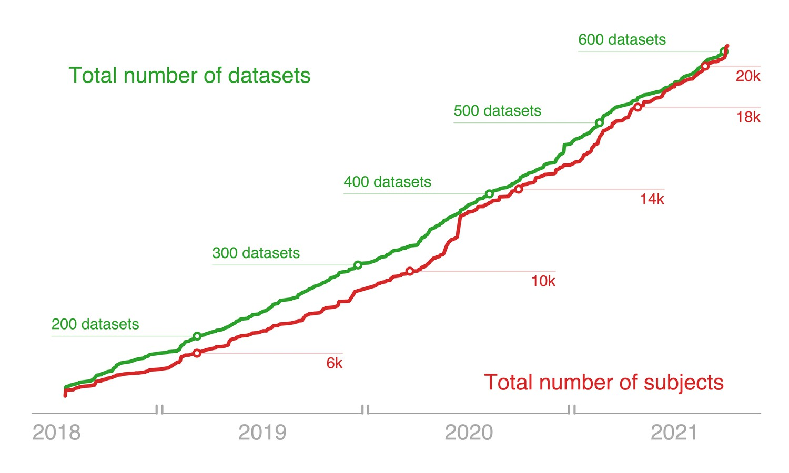
The OpenNeuro resource for sharing of neuroscience data, Markiewiezc et al.
Notes:
Open neuroscience

Slide 30
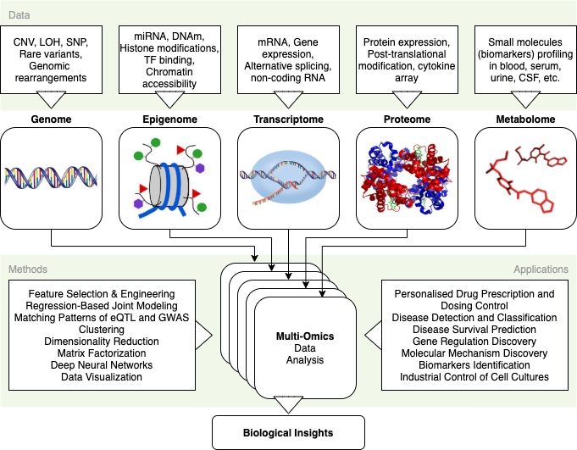
Multi-omics data

Slide 31
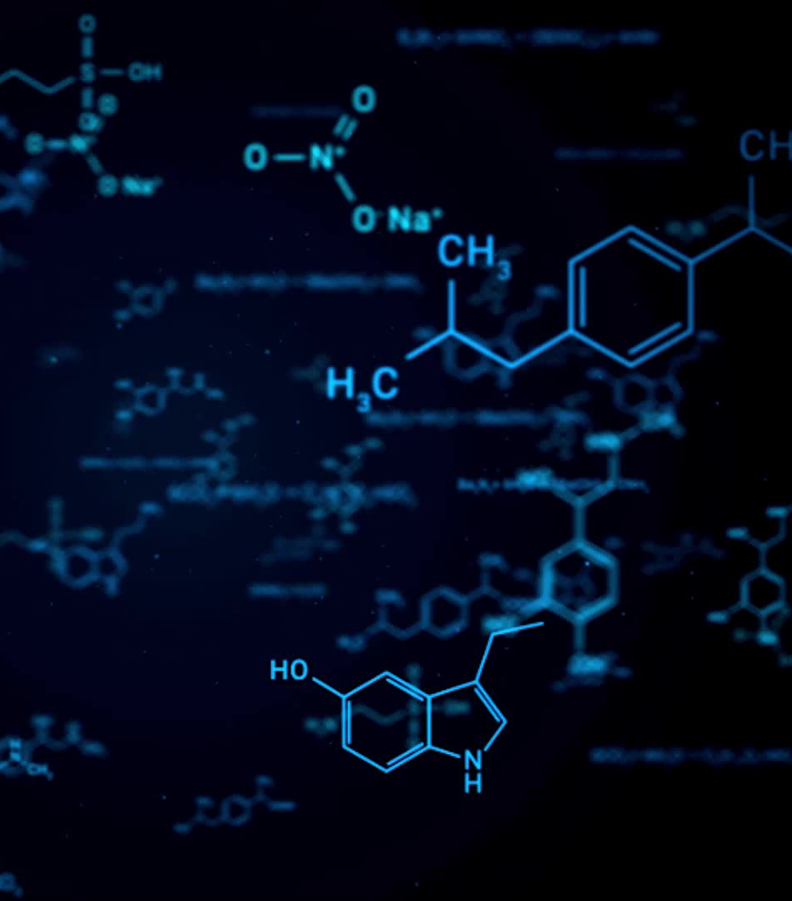
Get to know Neuroscience Data
Electrophysiological Data
Calcium Imaging Data
RNA sequencing data
scRNA
Bulk RNA
Text Data

Slide 32

Python for Data Science

Slide 33


Anaconda
Package Manager
Easy to create virtual enviroments (VE)
Why Ves?
Python Version
Package Version
OS Libaries

Slide 34
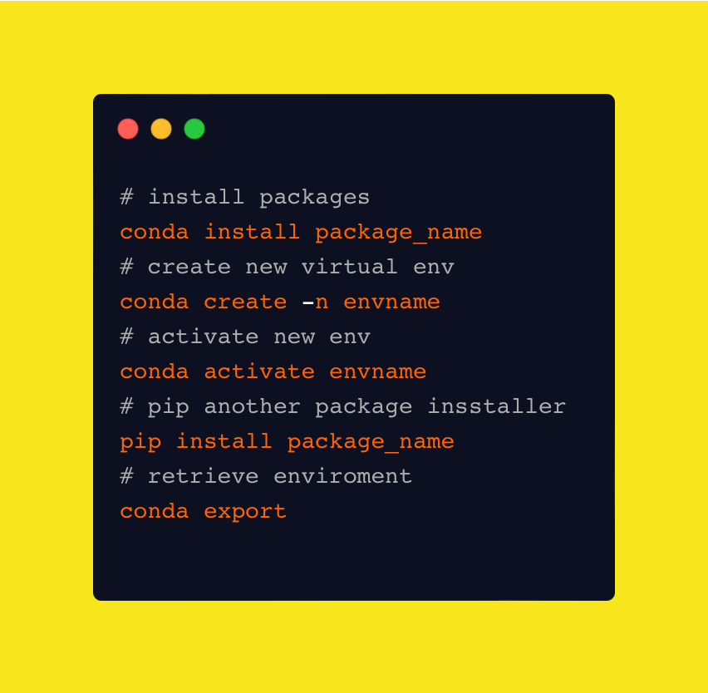
How to use conda
This allows us to create new enviroments for each individual project
https://www.anaconda.com
Anaconda/Miniconda differences?

Slide 35
Why Python????
It‘s easy!
Feels like english
Higher level language that abstracts away lower level programming paradigms from the user
Scripting- and OOP enabled
High user support
Continous development

Slide 36
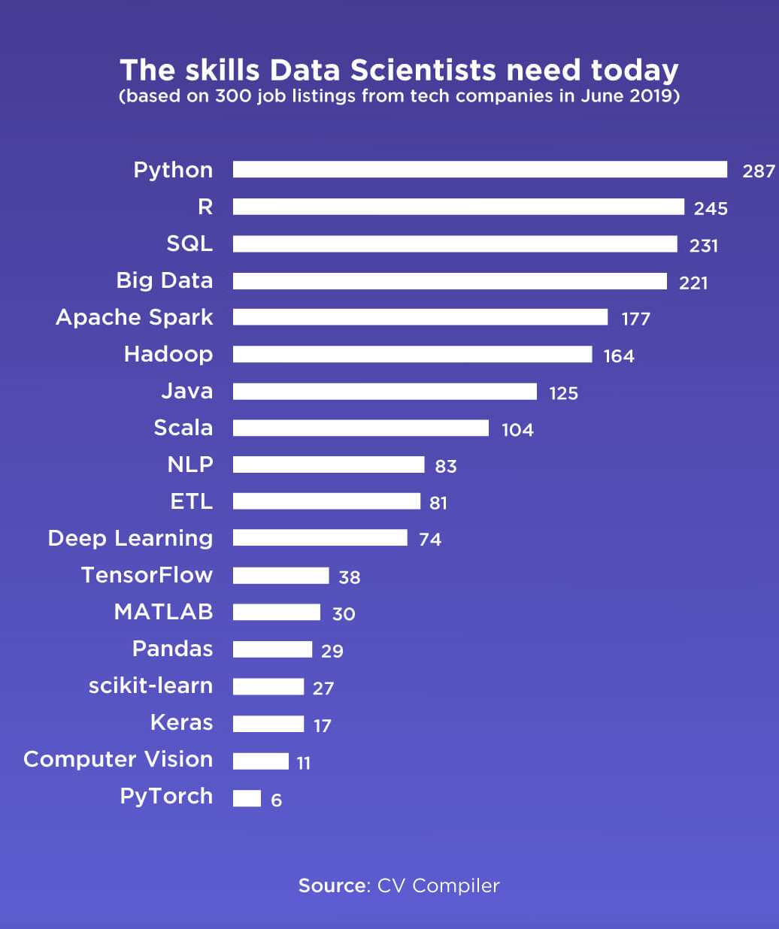
Python is in high demand!
https://jelvix.com/blog/top-data-science-programming-languages

Slide 37
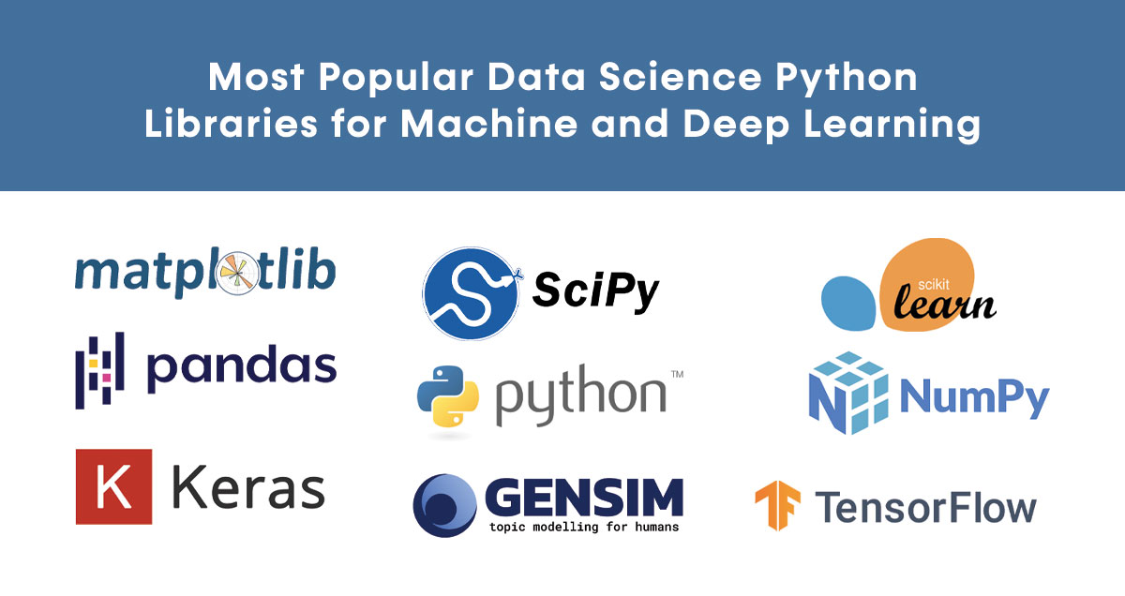
Matplotlib
Visualization
SciPy, Sklearn, Statsmodel
Statistics and ML
TensorFlow, Keras
Deep Learning
Pandas
DataFrame Processing
Numpy
Array Processing
GENSIM
NLP

Slide 38
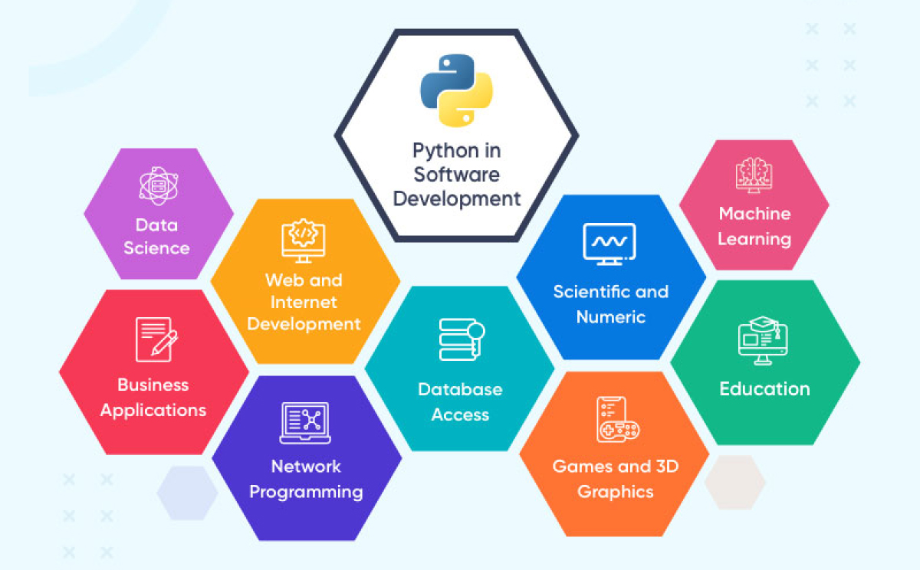
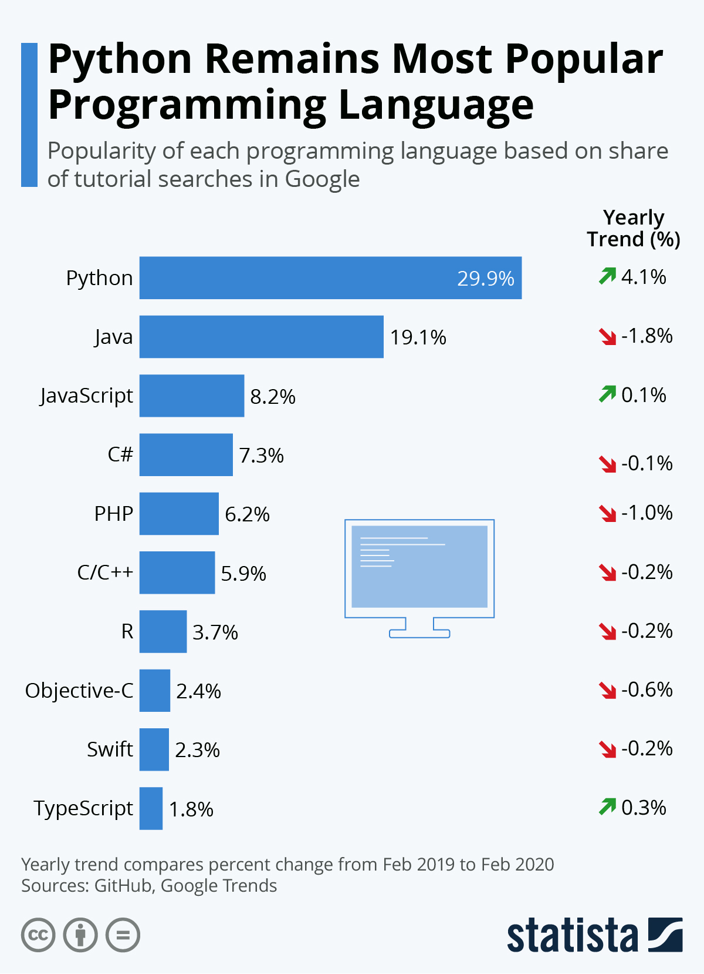
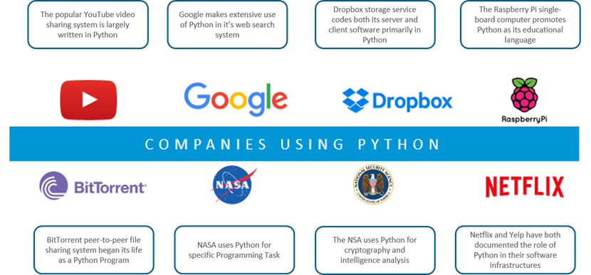
Python in a nutshell!

Slide 39
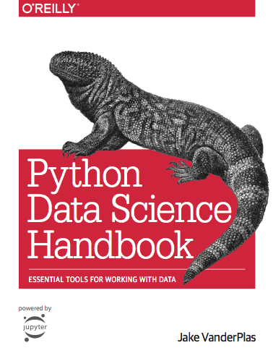
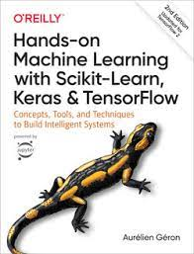
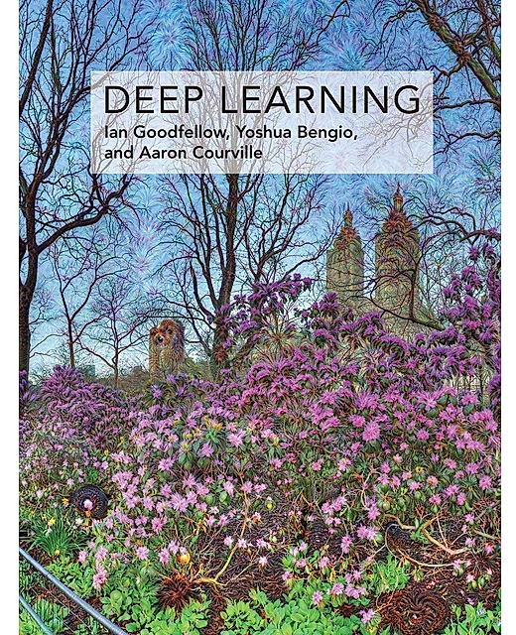
Recommended Books

Slide 40
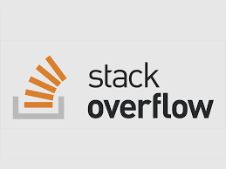





Where to get help?

Slide 41
Compiled vs. Interpreted
Source Code
The code you try to run
Translated
Converts code into machine interpretable code
Compiled
Before Runtime
Interpreted
At Runtime

Slide 42

Python Basics

Slide 43
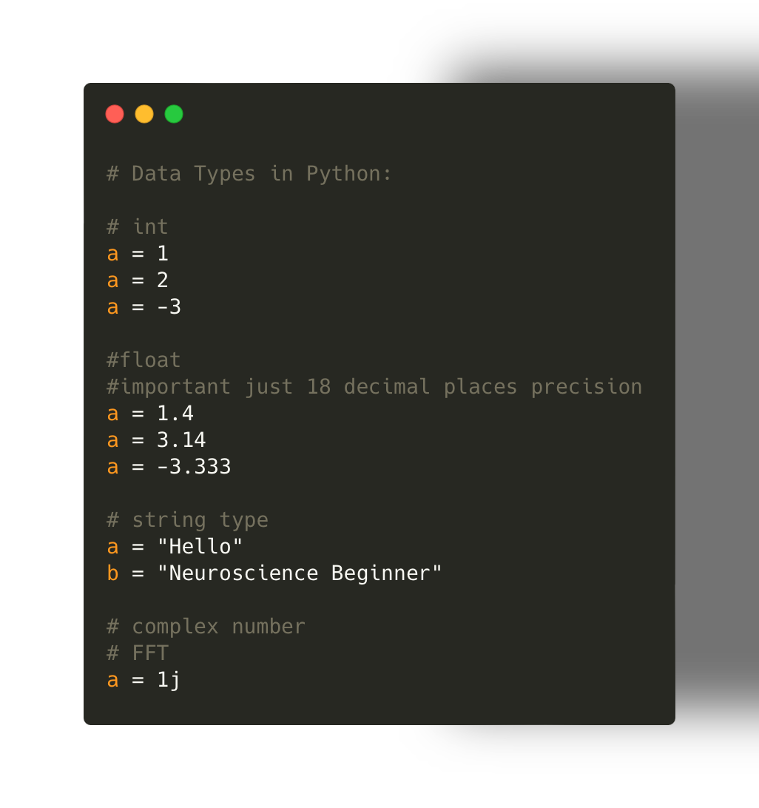
Data types in Python:
In addition:
bool = True/False
Bytes = b‘hello‘
Bytearrays

Slide 44
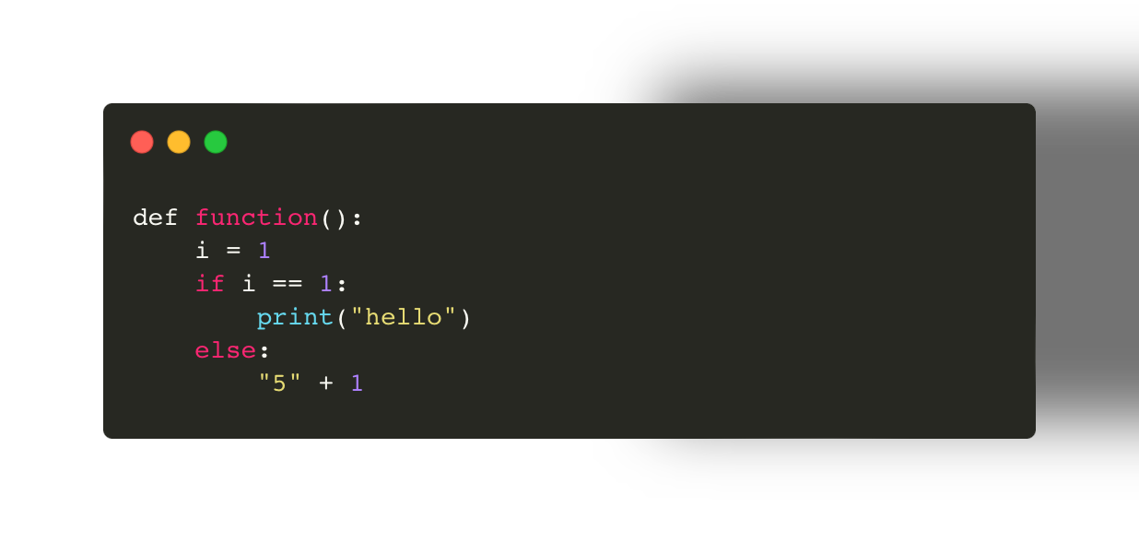
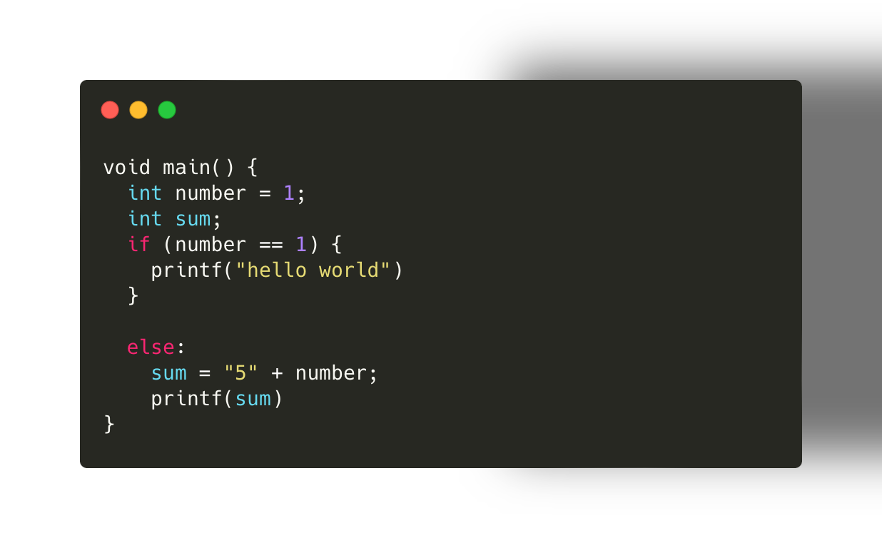
Dynamical typing
Type checking occurs at runtime
Types can be coerced
Important: Compiled languages can be dynamic

Slide 45
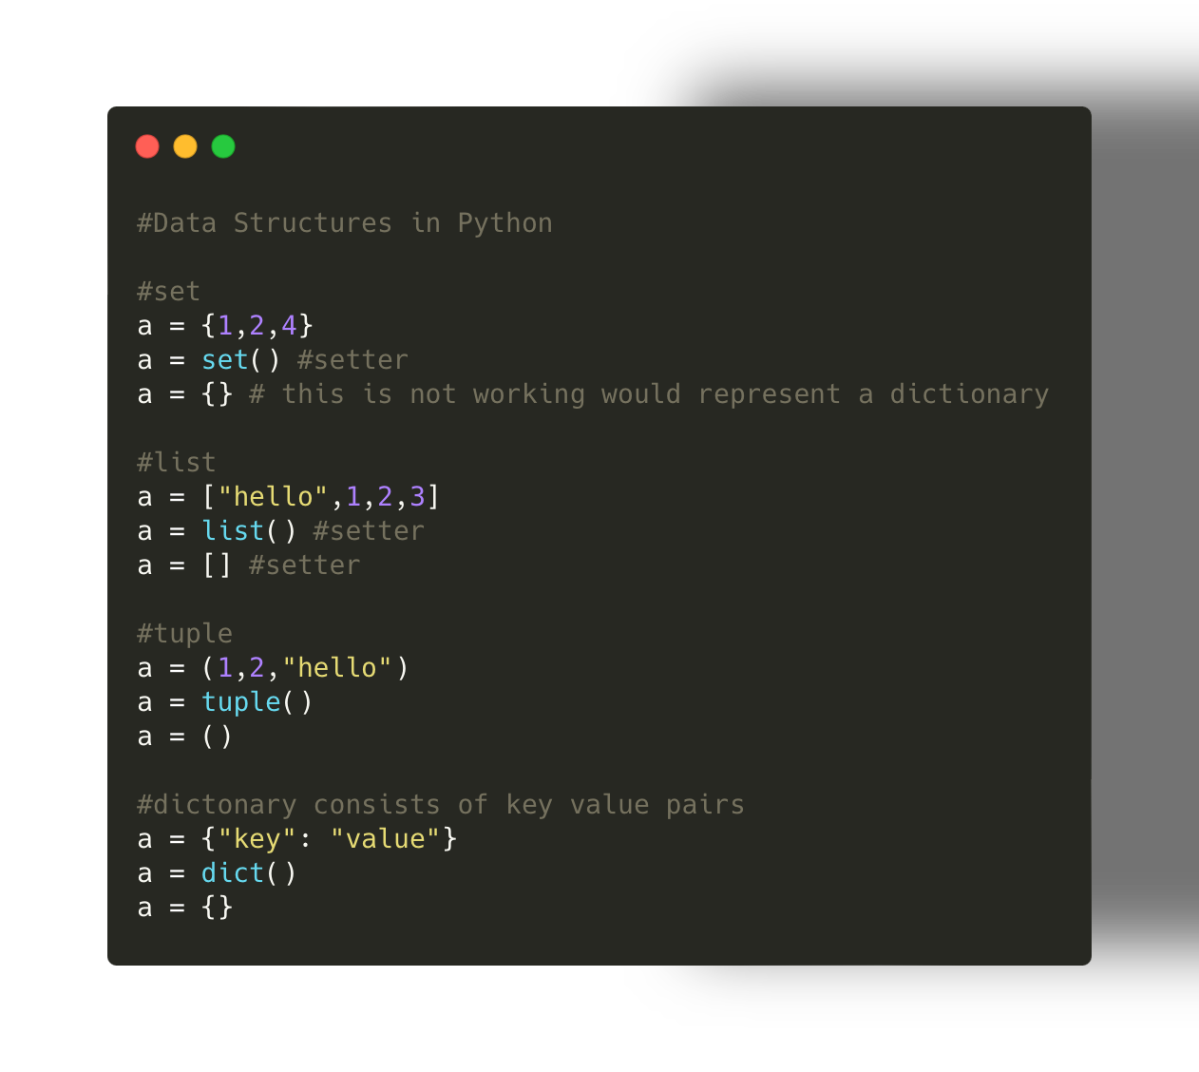
Data Structures in Python
In addition:
Frozensets (immutable)
Arrays (list of on data type)
Structs
Classes
Notes:
Tuple immutable and sorted
Set mutable and unsorted
Dictionary per definition unsorted but there are sroted variants

Slide 46
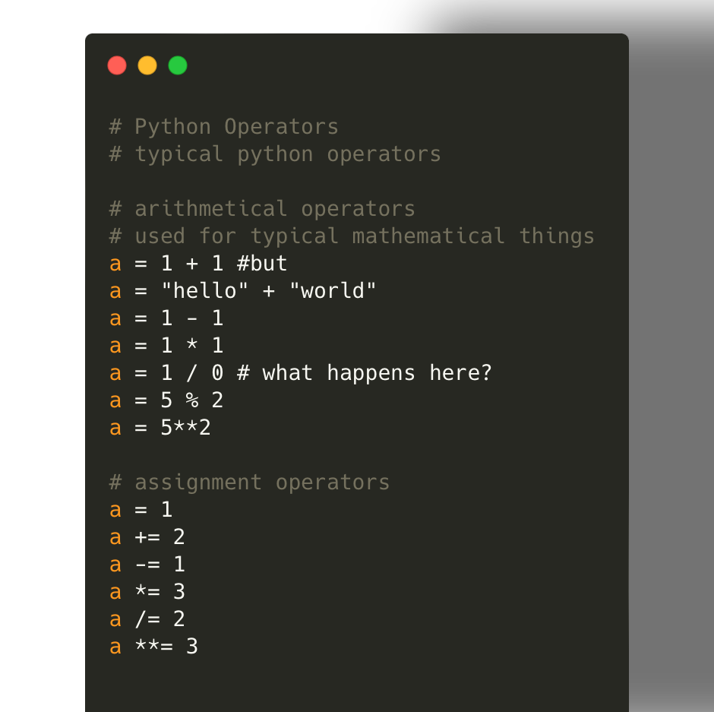
Python Operators
Operates on variables/inputs
Can assign values to variables
Can compare variables
Can act as logical gates

Slide 47
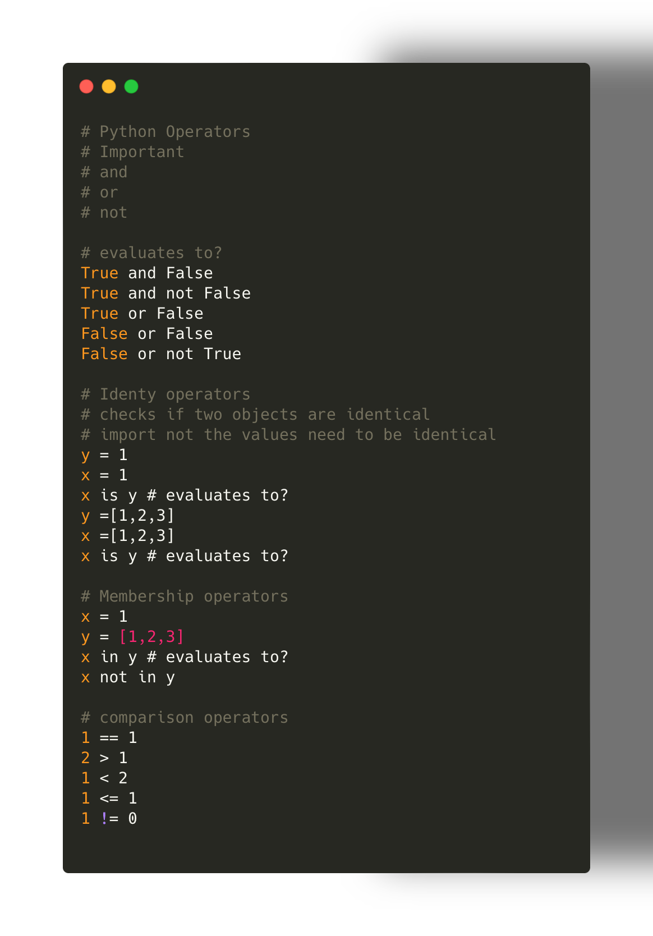
Operators Part 2
More operators:
Bitwise operators
& (AND)
| (OR)
^ (XOR)
~ (NOT)
What is the difference to and and or e.g.
Notes:
Bitwise operators are usually used on integers or byte number while.
In addition and and or are short-circuiting while & and or are not short-circuting
Example True or sys.exit(1) → no exit
True | sys.exit(1) → exit

Slide 48
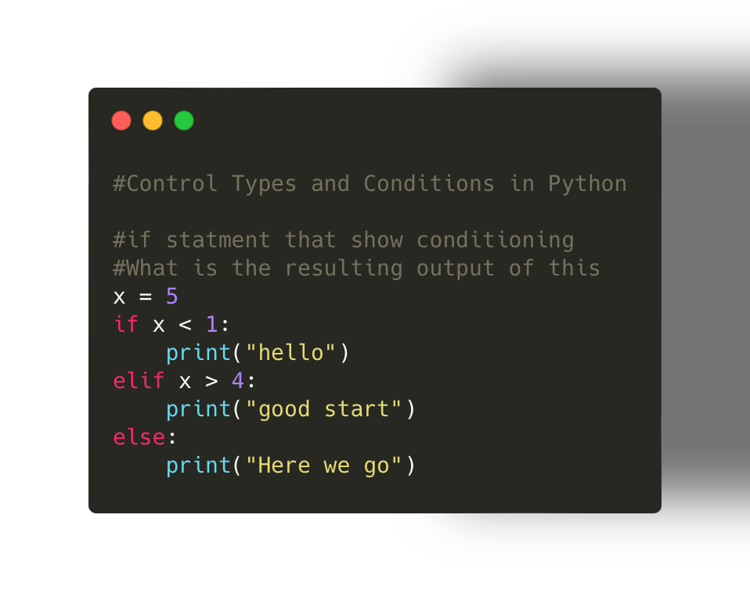
Condition/ Control Flow
If elif … else
Important check indents
Always evaluate top to bottom
If on condition evaluates to True code is returning
Notes:
Can someone think about combining the operators and the control flow here?

Slide 49
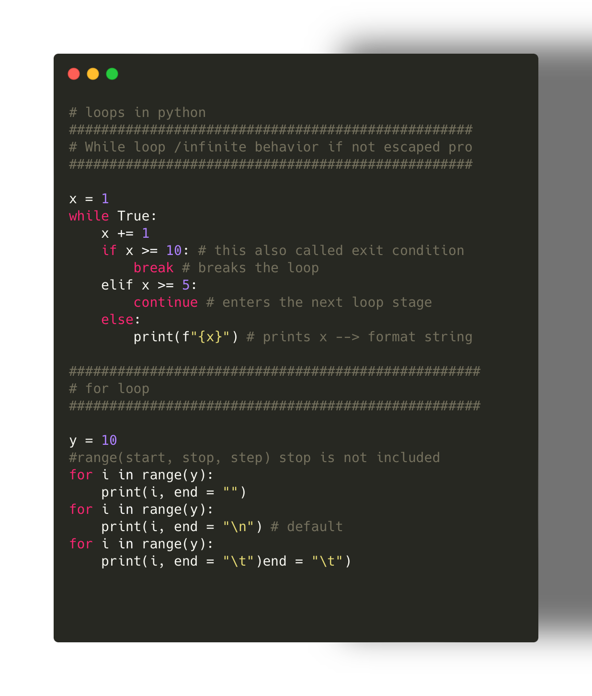
Loops
There is not a direct equivalent to a do while loop in python

Slide 50
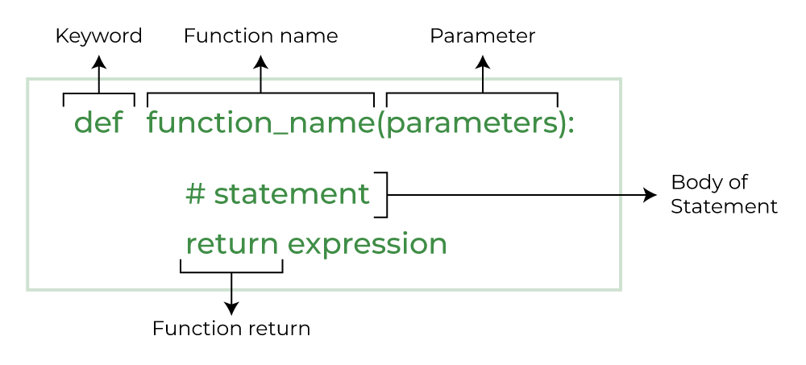
Functions in Python
Lets dive into Functions
Function Scope
Notes:
Parameters:
Default parameters:
best practice
Scope:

Slide 51
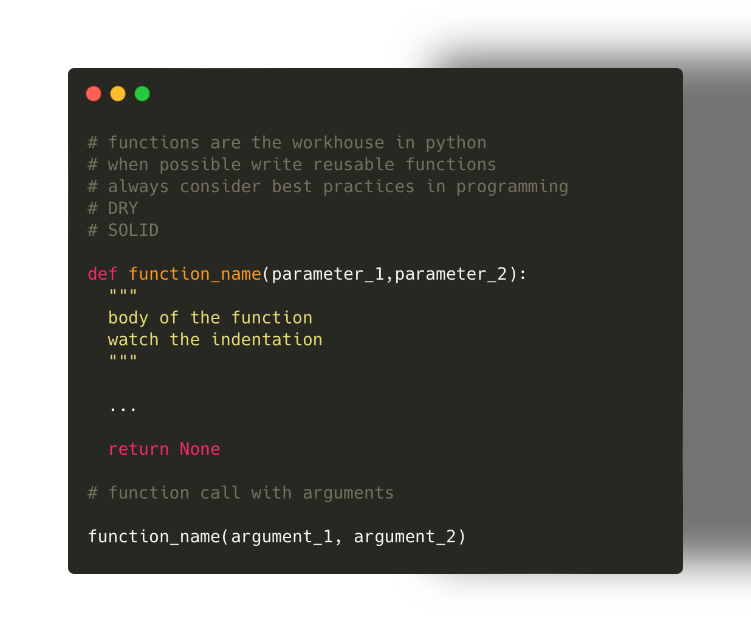
How to use a function in python
Why should we use functions instead of pure scripting?
Best practices:
DRY
SOLID

Slide 52
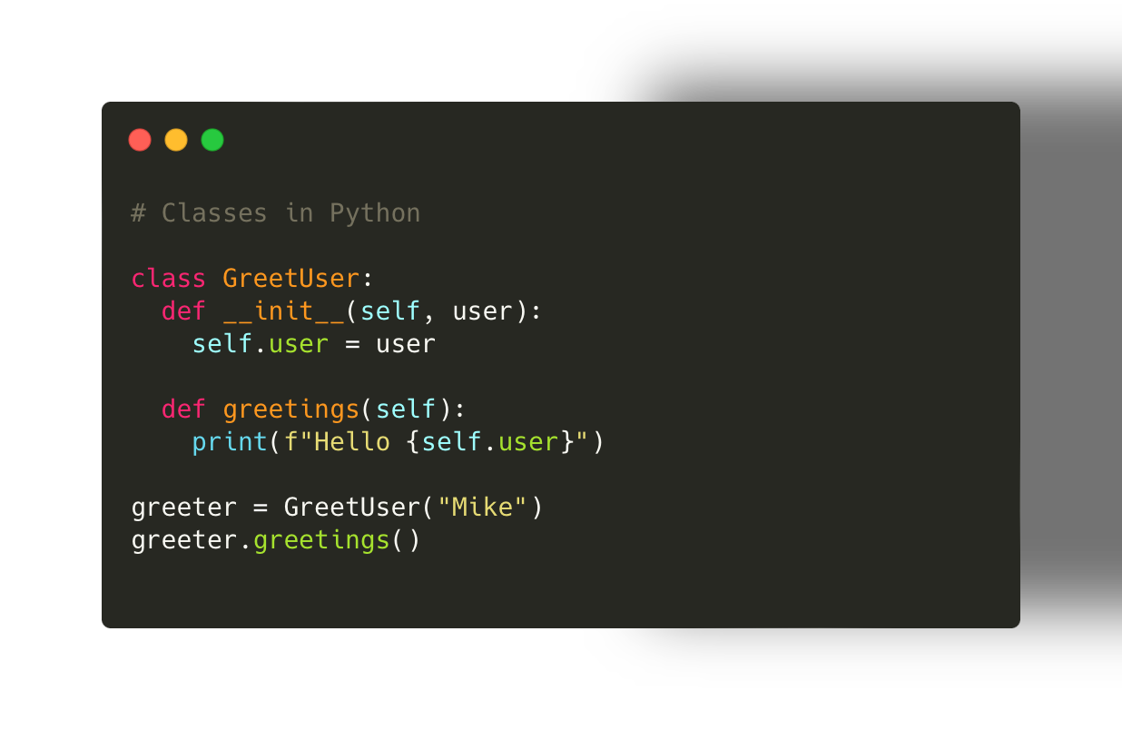
How to implement classes in python

Slide 53
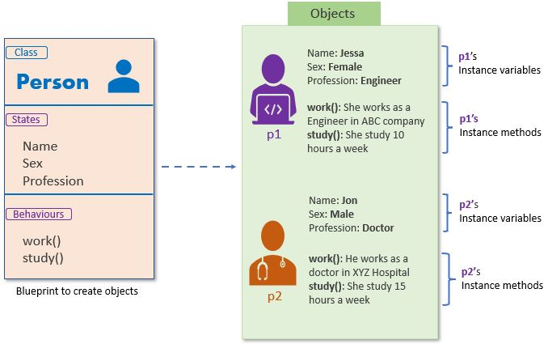
Classes in Python (OOP) Excercise
Object Oriented Programming
Abstraction
Adaptability
https://pynative.com/python-classes-and-objects/

Slide 54
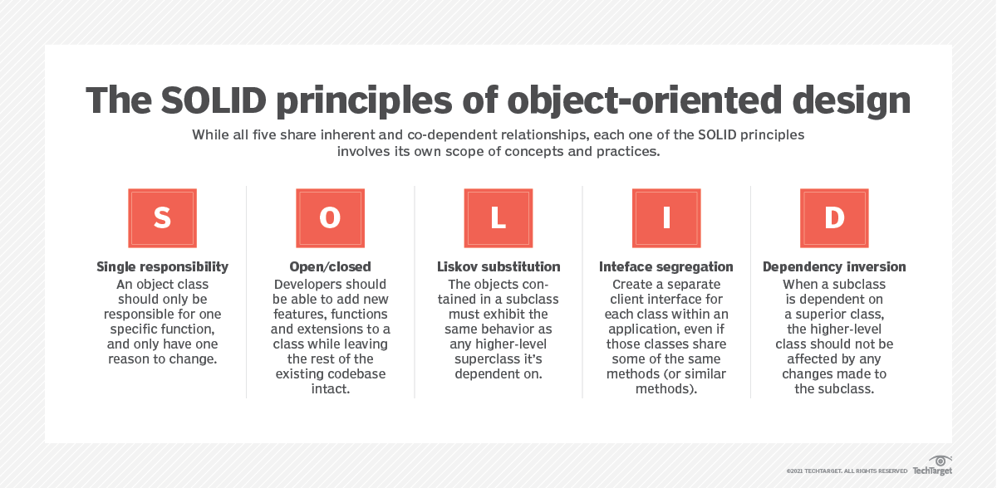
SOLID Principles

